Slide 1
PROJECT PRESENTATION 1 TYPES OF STATISTICS
BY
GAYATHRI R

Slide 2
INTRODUCTION TO STATISTICS
The practice or science of collecting and analysing numerical data in large quantities, especially for the purpose of inferring proportions in a whole from those in a representative sample.
Collection of data
Presentation of data
Analysis of data and
Interpretation of data

Slide 3
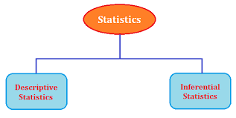
TYPES TO STATISTICS

Slide 4
1. Descriptive Statistics
The branch of statistics devoted to the summarization and description of data is called Descriptive Statistics
2. Inferential Statistics
The branch of statistics concerned with using sample data to make an inference about a population of data is called Inferential Statistics.

Slide 5
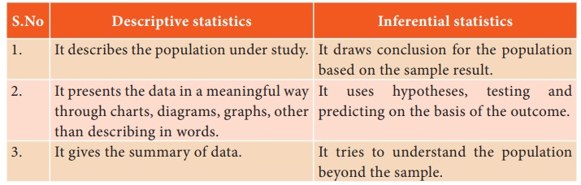
Major differences between Descriptive Statistics and Inferential Statistics

Slide 6
Conclusion
Statistics allow you to evaluate claims based on quantitative evidence and help you differentiate between reasonable and dubious conclusions.

Slide 7
ANY QUESTIONS

